Slide 1

Thom Andretti Michael Brown Chris Dzombak

Slide 2
Problem
We want to explore different photographers’ interpretations of the world around us
We want to see what something looks like at different times or seasons

Slide 3
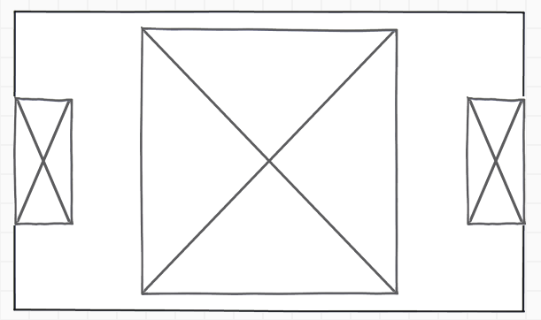
Solution
Android app that connects with flickr
Location based search
Directionally aware

Slide 4
Big Picture
Learn basics of Android programming
Networking
Location/compass API
flickr API
Get experience using 3rd-party API
Assess feasibility of writing a flickr app for 10-week project

Slide 5
Secret Sauce
Directionally aware search of nearby photos

